Slide 1
Use Models to Build better apps faster!
Tim Sheiner
Platform Principal Designer
tsheiner@salesforce.com
@tsheiner

Slide 3

Forward-Looking Statement
Statement under the Private Securities Litigation Reform Act of 1995
This presentation may contain forward-looking statements that involve risks, uncertainties, and assumptions. If any such uncertainties materialize or if any of the assumptions proves incorrect, the results of salesforce.com, inc. could differ materially from the results expressed or implied by the forward-looking statements we make. All statements other than statements of historical fact could be deemed forward-looking, including any projections of product or service availability, subscriber growth, earnings, revenues, or other financial items and any statements regarding strategies or plans of management for future operations, statements of belief, any statements concerning new, planned, or upgraded services or technology developments and customer contracts or use of our services.
The risks and uncertainties referred to above include – but are not limited to – risks associated with developing and delivering new functionality for our service, new products and services, our new business model, our past operating losses, possible fluctuations in our operating results and rate of growth, interruptions or delays in our Web hosting, breach of our security measures, the outcome of any litigation, risks associated with completed and any possible mergers and acquisitions, the immature market in which we operate, our relatively limited operating history, our ability to expand, retain, and motivate our employees and manage our growth, new releases of our service and successful customer deployment, our limited history reselling non-salesforce.com products, and utilization and selling to larger enterprise customers. Further information on potential factors that could affect the financial results of salesforce.com, inc. is included in our annual report on Form 10-K for the most recent fiscal year and in our quarterly report on Form 10-Q for the most recent fiscal quarter. These documents and others containing important disclosures are available on the SEC Filings section of the Investor Information section of our Web site.
Any unreleased services or features referenced in this or other presentations, press releases or public statements are not currently available and may not be delivered on time or at all. Customers who purchase our services should make the purchase decisions based upon features that are currently available. Salesforce.com, inc. assumes no obligation and does not intend to update these forward-looking statements.
Notes:
Key Message Salesforce is a publicly traded company. Customers should make buying decisions only on the products commercially available.
Talk Track Before I begin, just a quick note that you should base your purchasing decisions on products and services that are currently available.

Slide 4
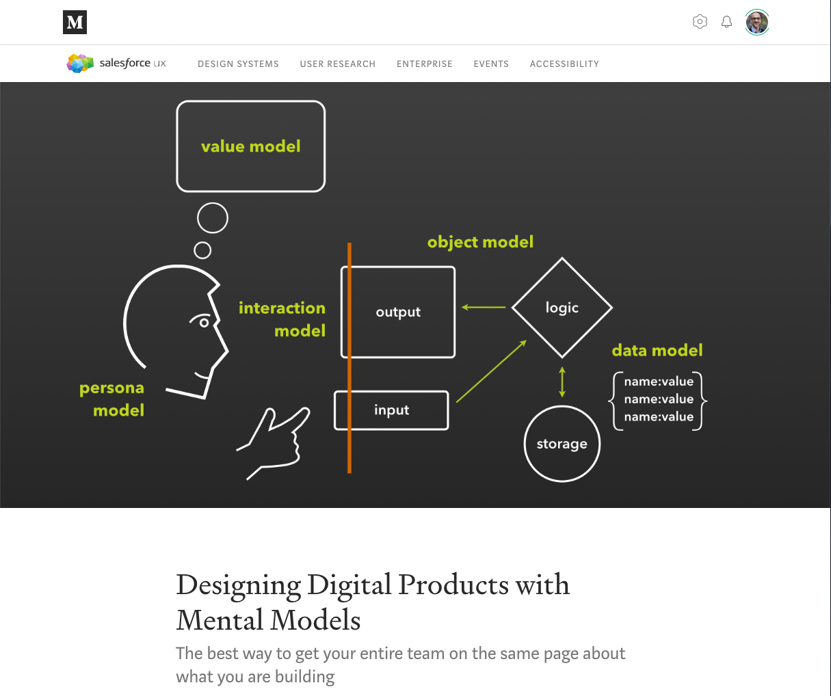
Agenda Today, we’ll talk about
The hardest part of software development
Modeling software as a Digital Machine
Benefits of this approach

Slide 5
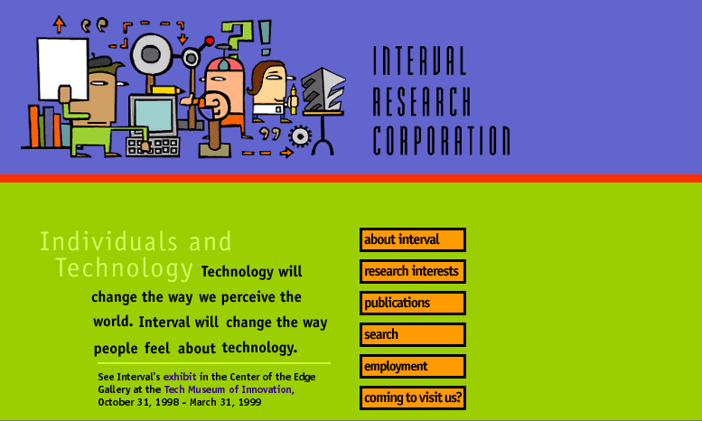
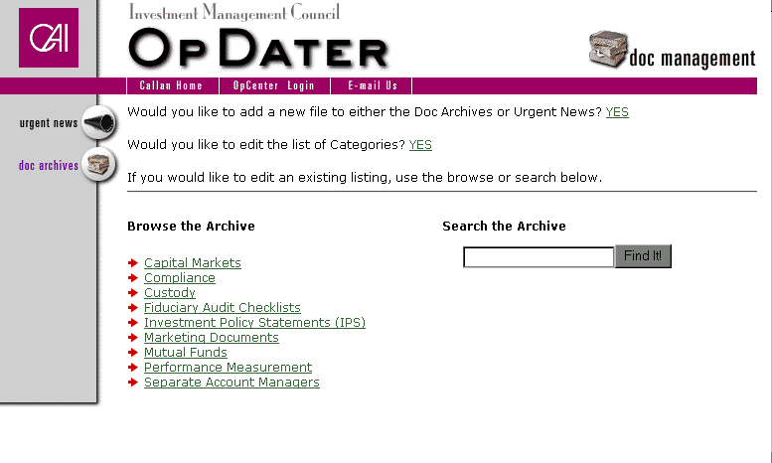
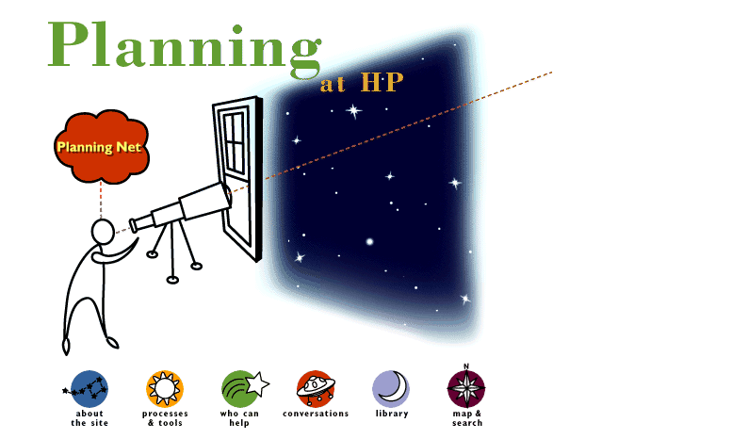
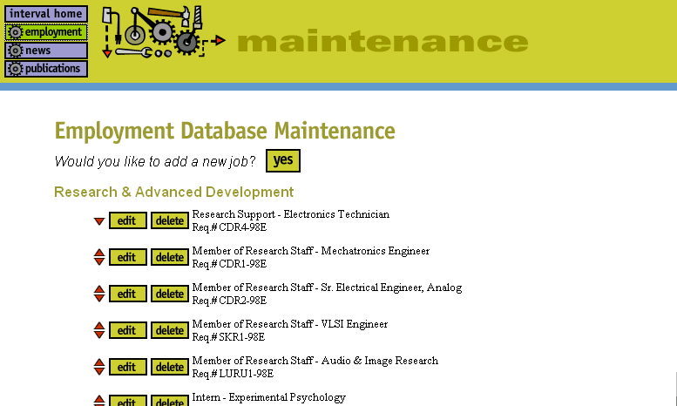
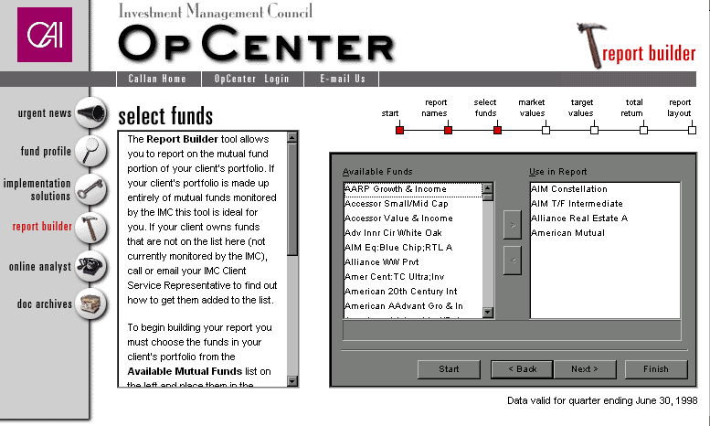
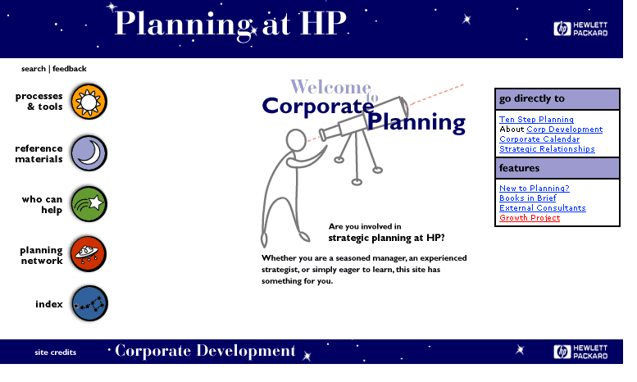
I’ve been designing software since the web began

Slide 6
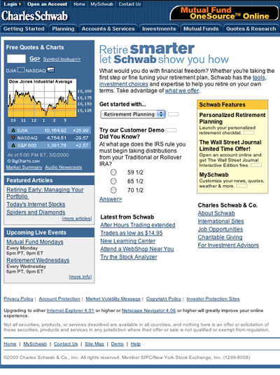
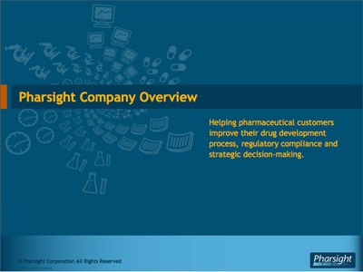
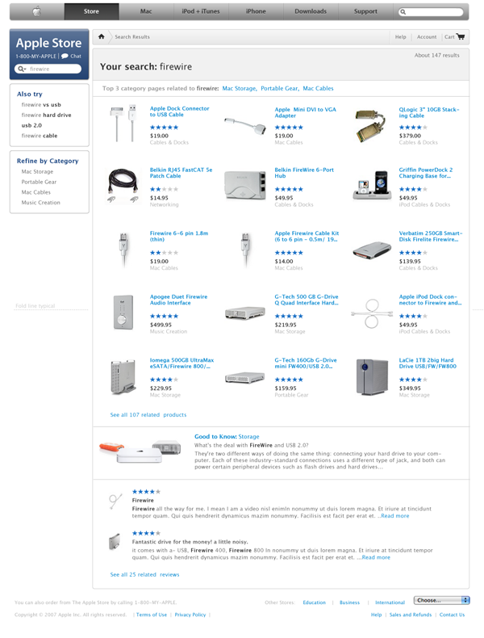
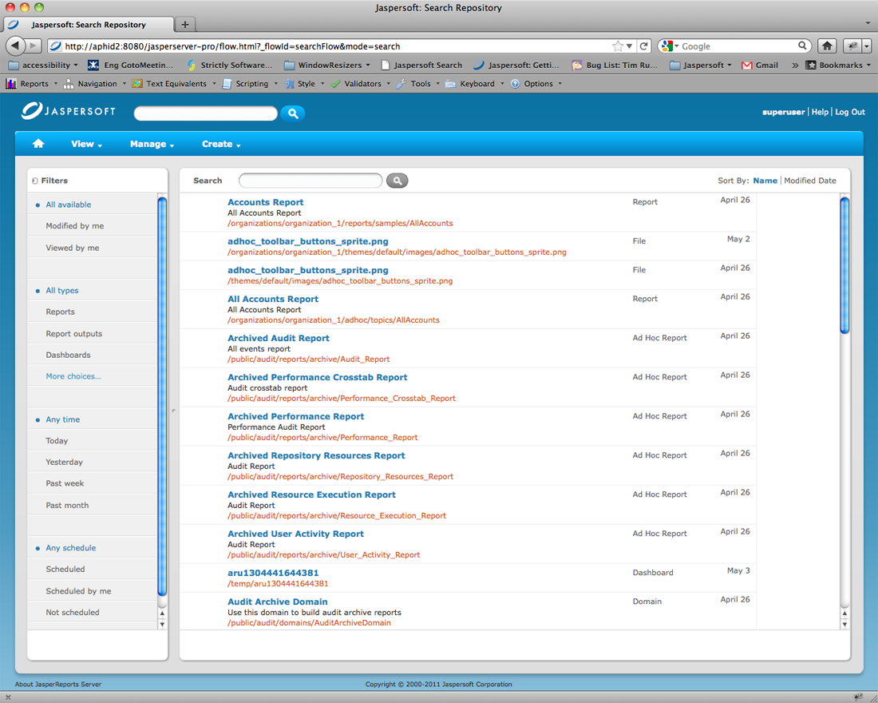
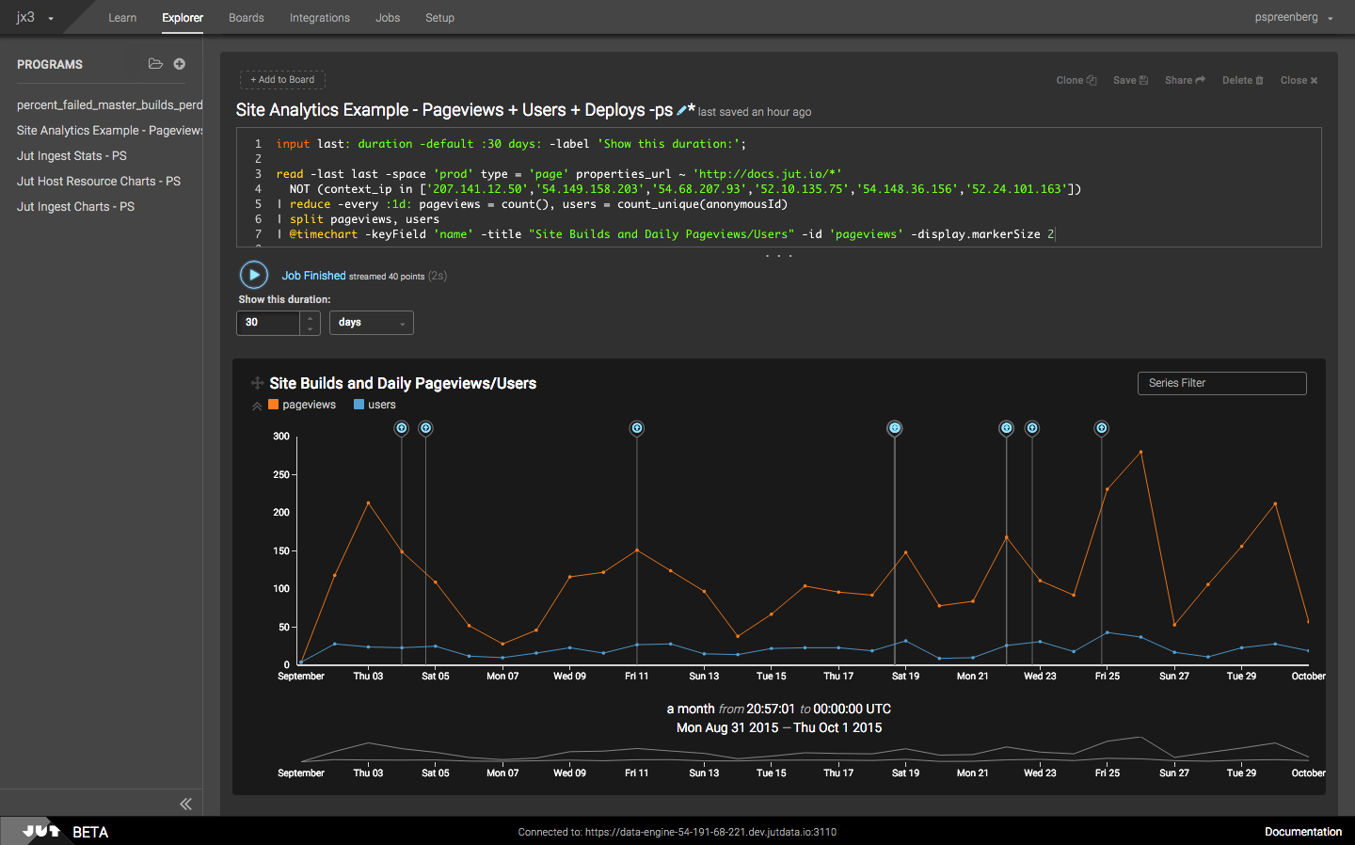
I’ve designed for large consumer companies you might know…
and small enterprise companies you probably don’t know.

Slide 7
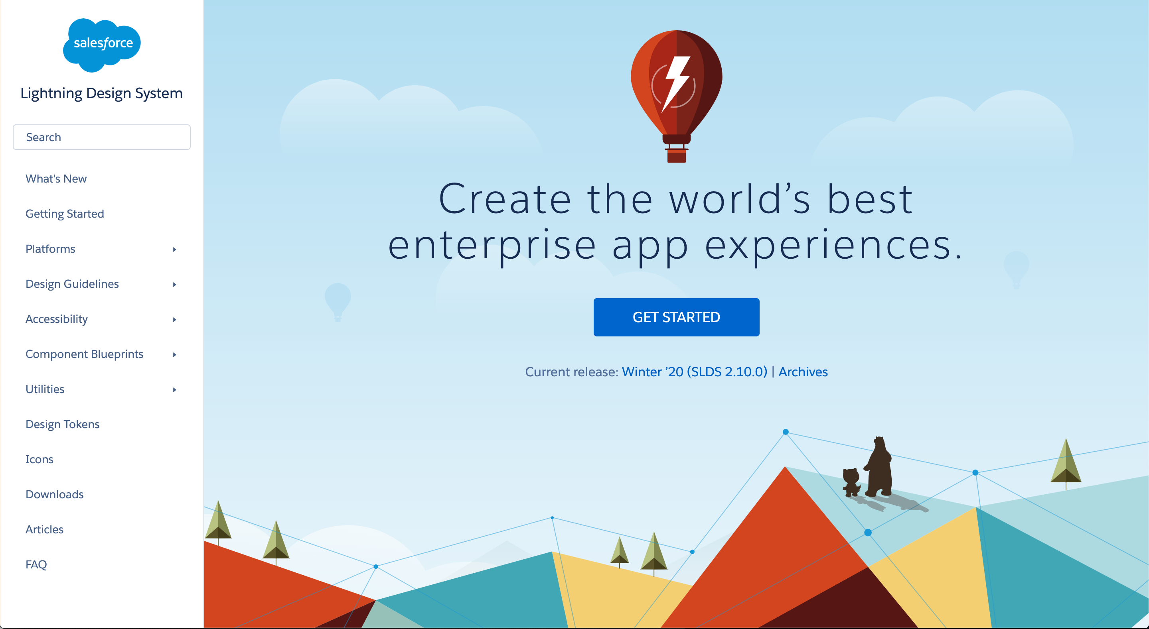
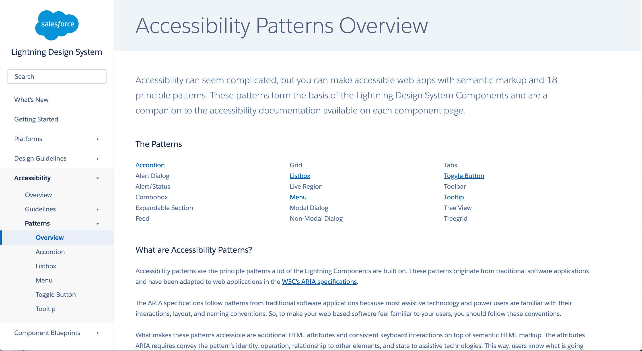
I started at Salesforce managing design system team.

Slide 8
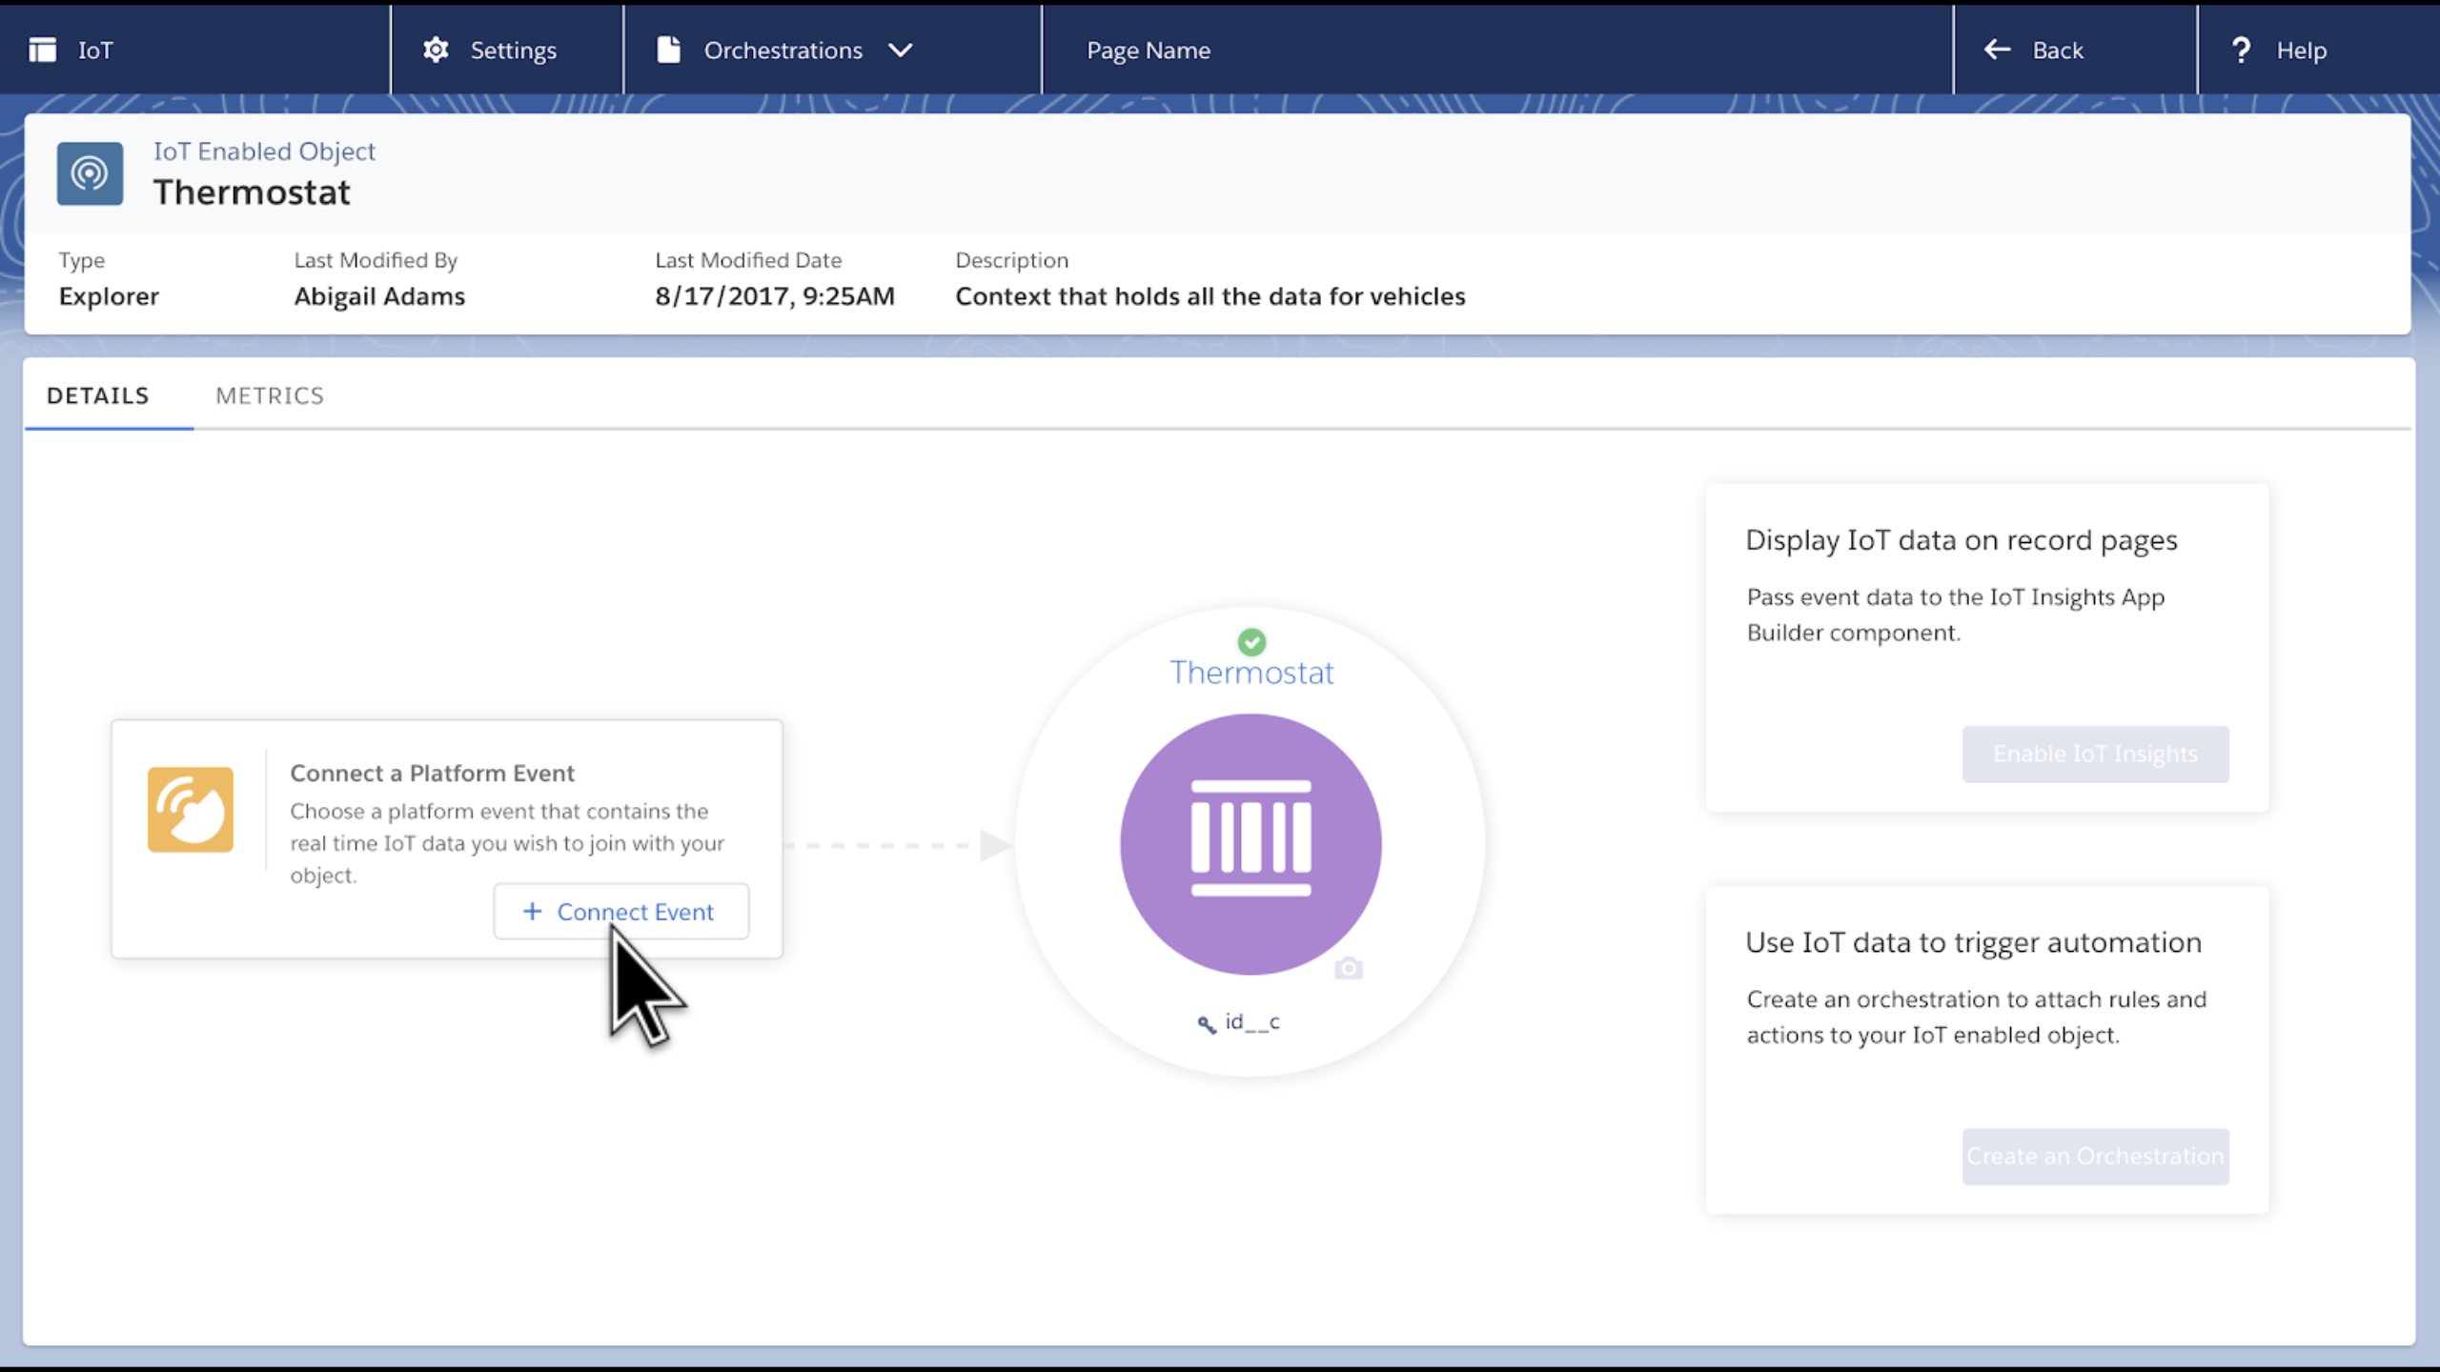
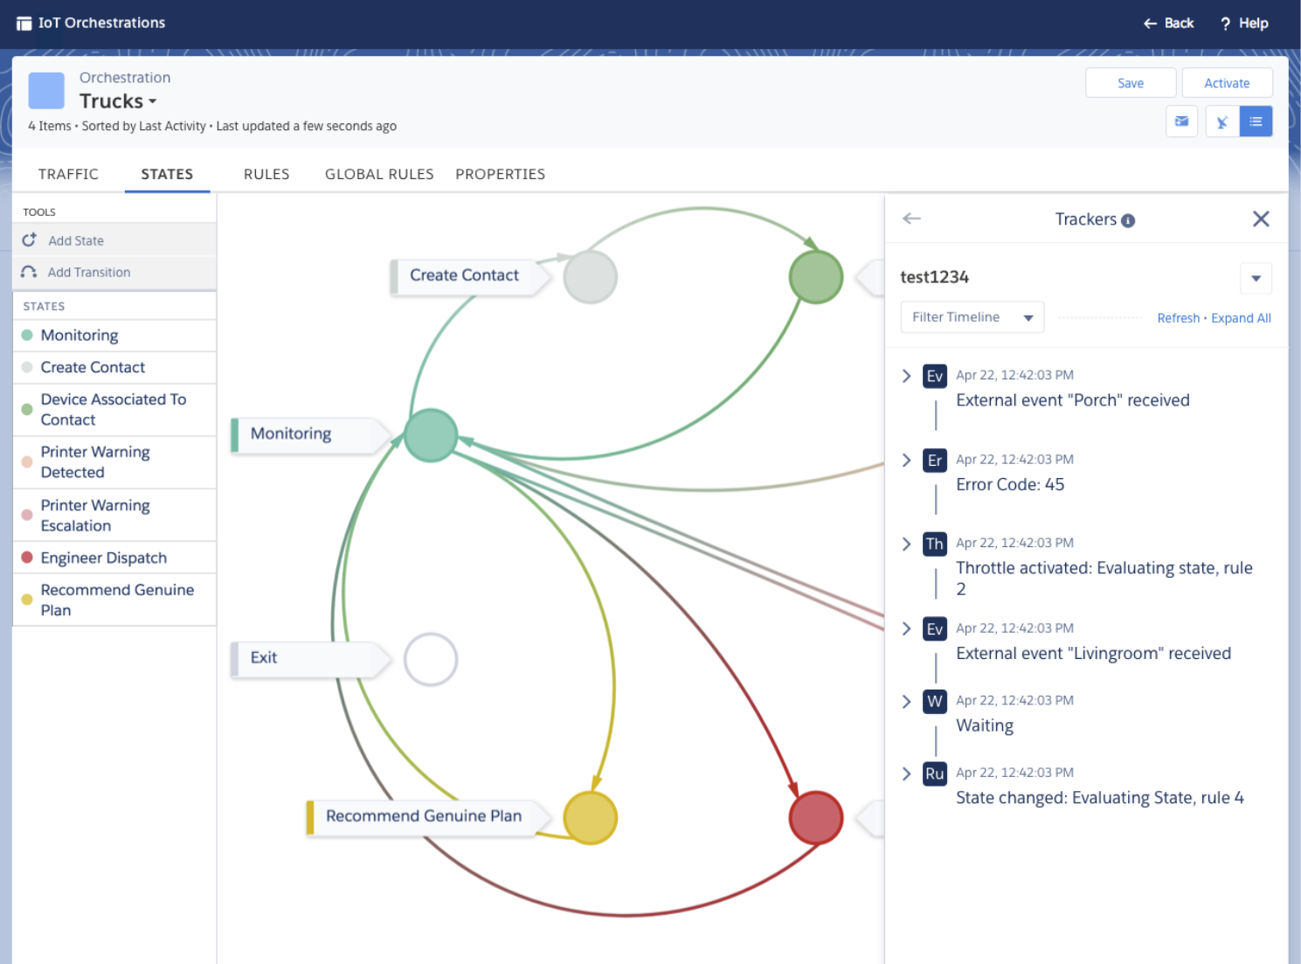
Next I worked on our IoT offering.

Slide 9
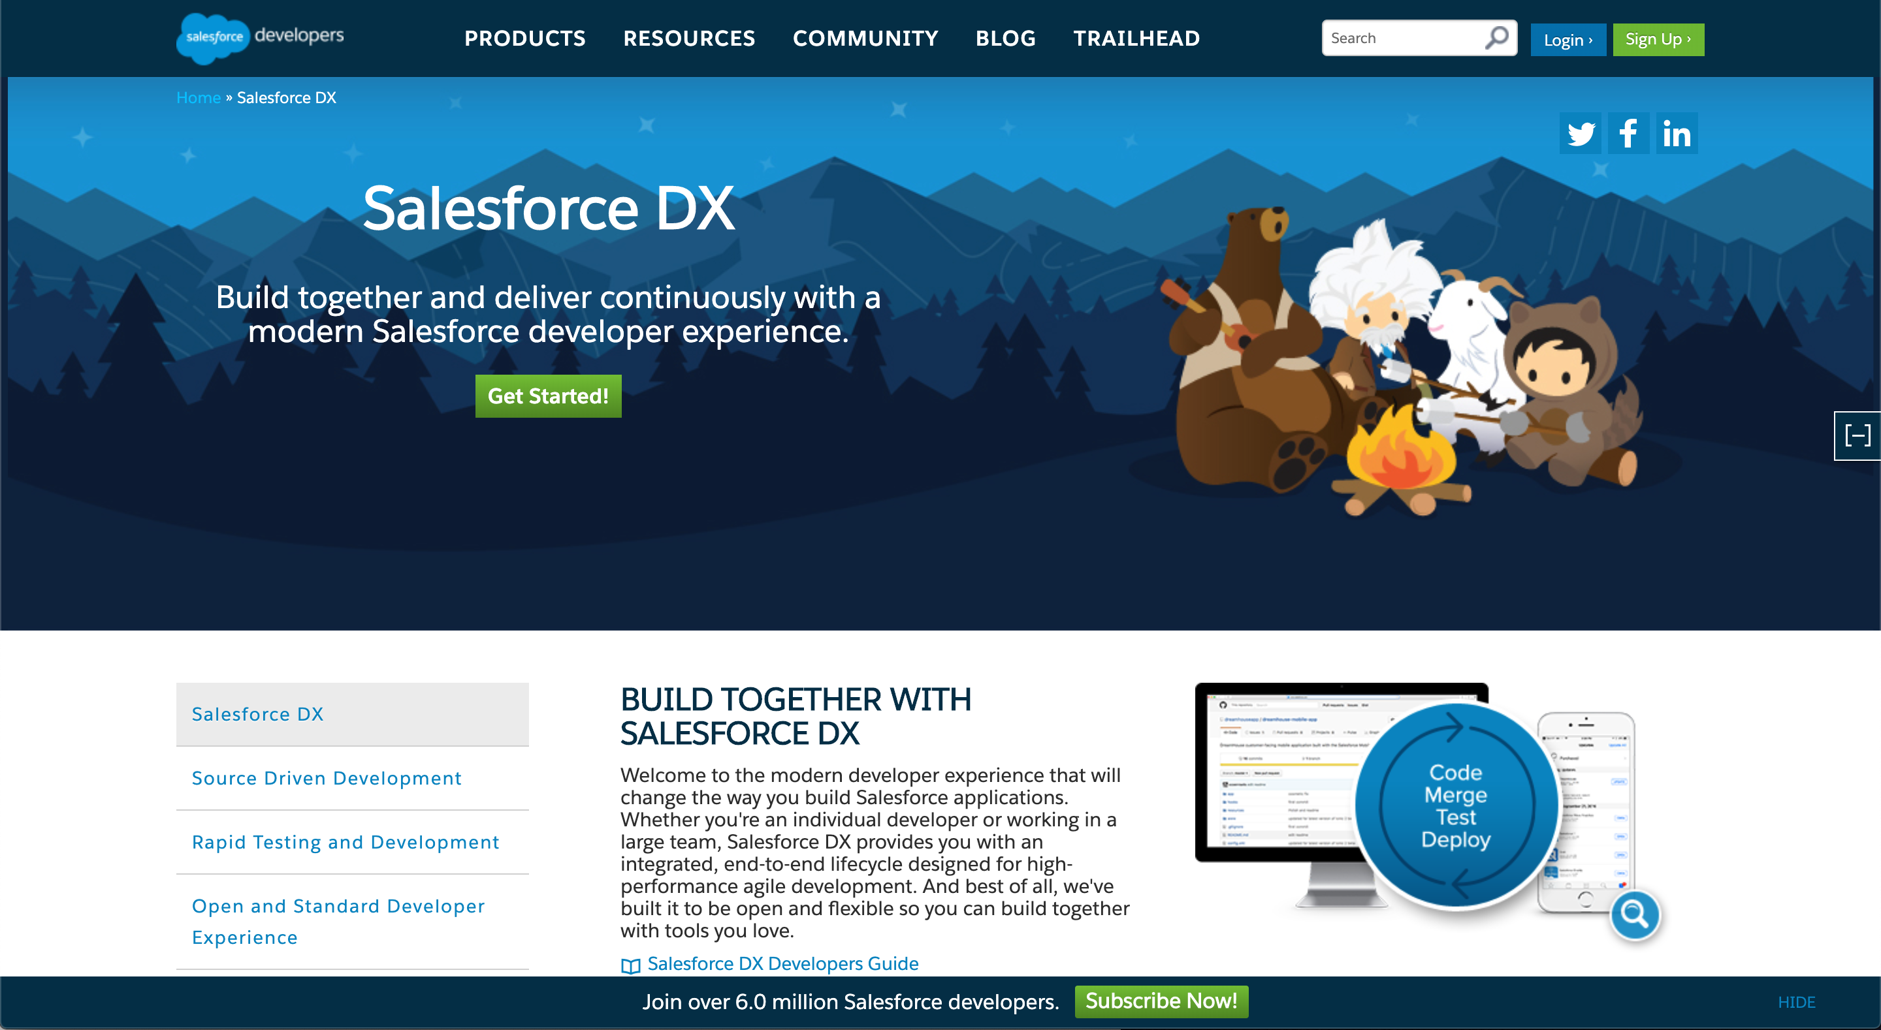
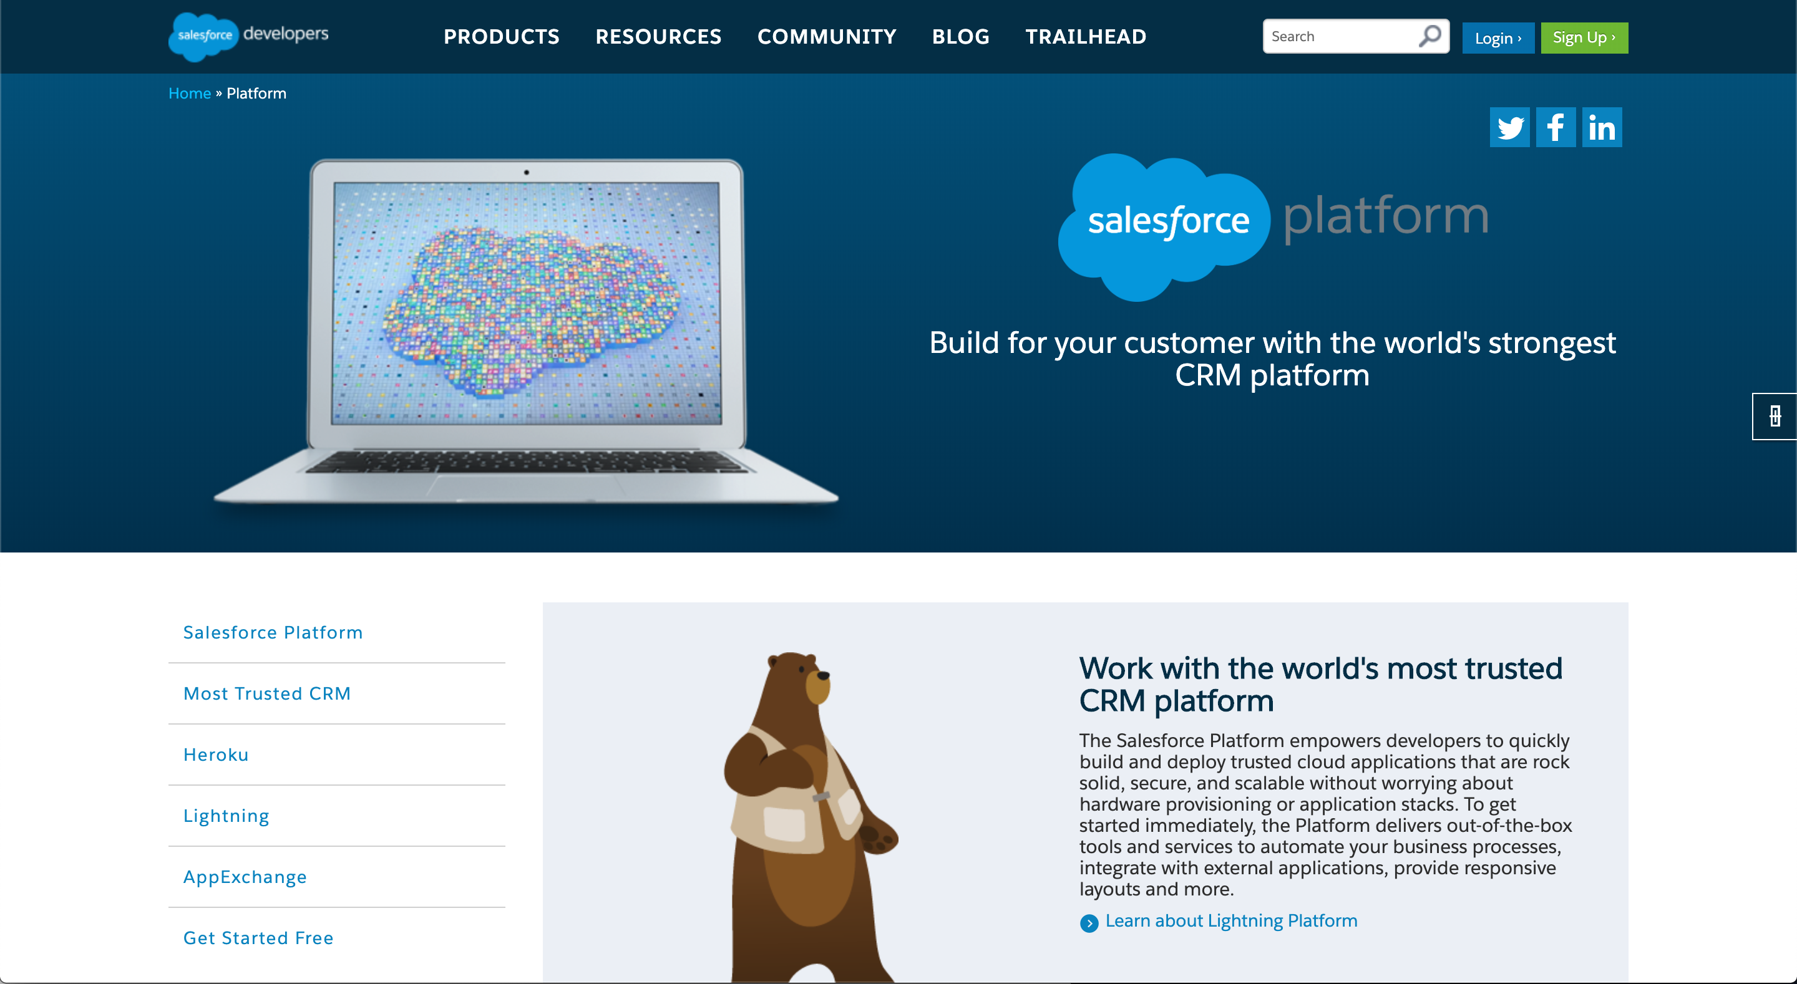
My current focus is our DX and Platform experiences

Slide 10
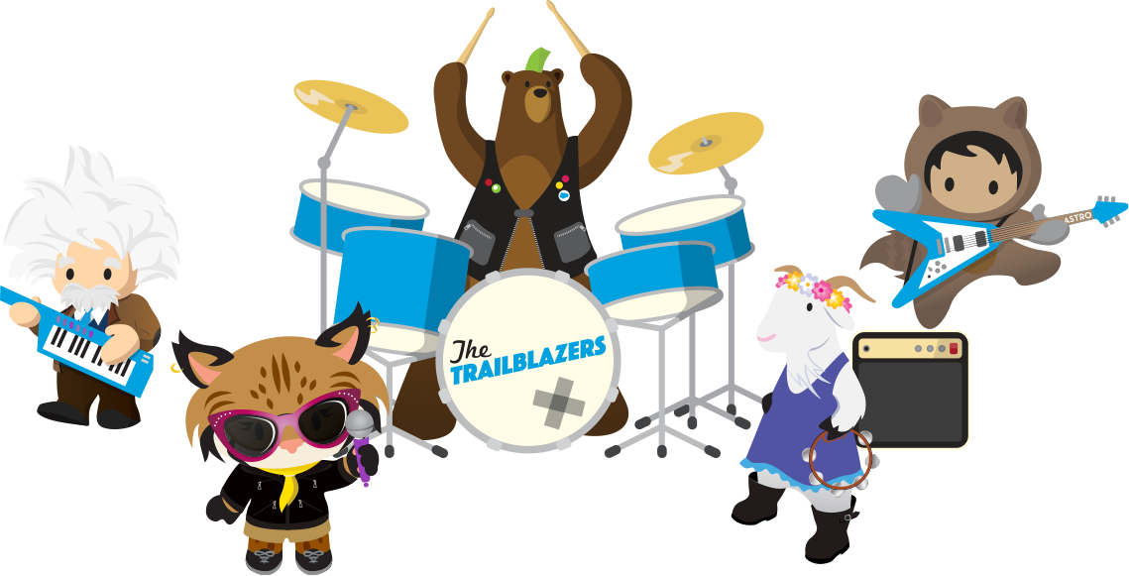
Software is a team sport.

Slide 11





Getting team alignment is the hardest part.

Slide 12




Product Manager
Designer
Product
Developer
End User

Slide 13
Product Manager
Designer
Product
Developer
End User

Slide 14
Unconscious bias
makes alignment hard.

Slide 15
If you can’t fix it, feature it!

Slide 16
Product Manager
Designer
Product
Developer
End User

Slide 17
My concern is value
My concern is interaction
My concern is data
Product Manager
I am the object of concern
Designer
Product
Developer
My concern is me
End User

Slide 18
A System of Models
value model
why is it useful?
interaction model
how do I use it?
data model
how is state managed?
object model
what is it?
persona model
who is it for?

Slide 19


The Digital Machine
value model
object model
output
logic
interaction model
persona model
{
}
input
name:value
name:value
name:value
storage
data model

Slide 20
“Models are ideas about the world—how it might be organized and how it might work.”
— Hugh Dubberly

Slide 21
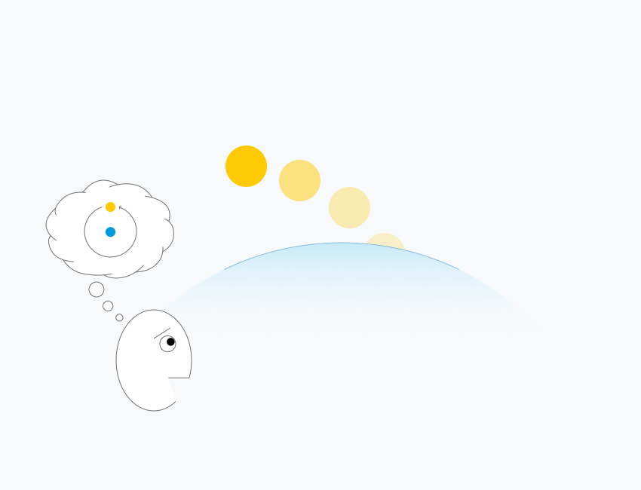
redrawn from dubberly, model of models, 2009

Slide 22
suggest
observations
models
frame & filter
redrawn from dubberly, model of models, 2009

Slide 23
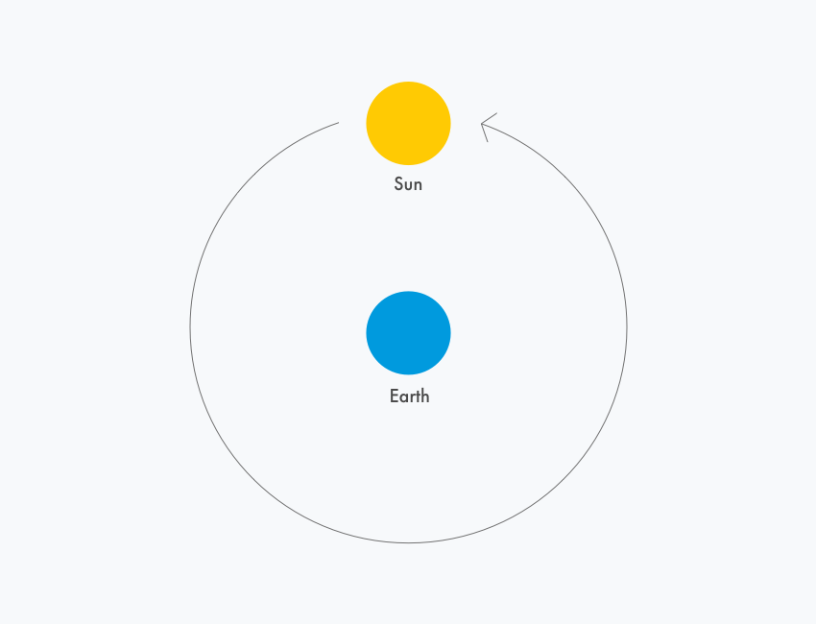
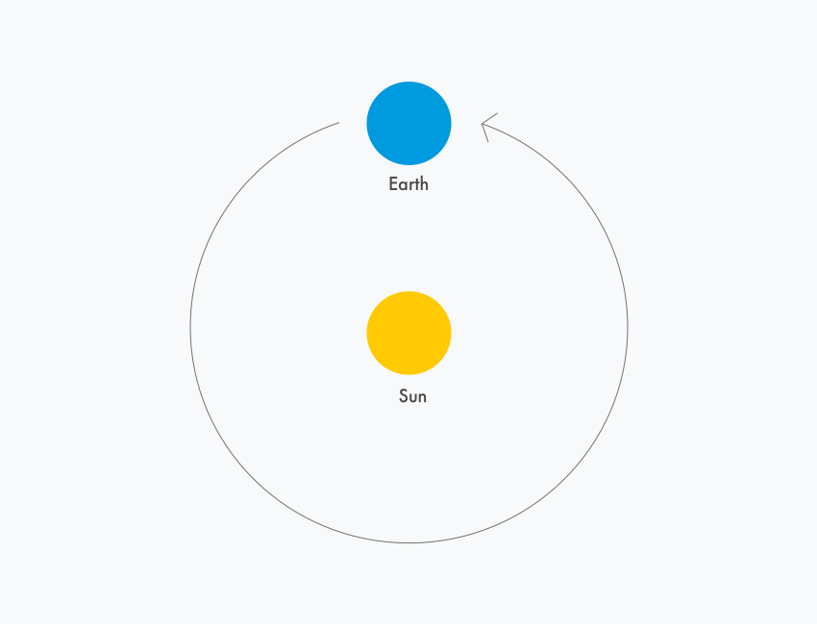
redrawn from dubberly, model of models, 2009

Slide 24
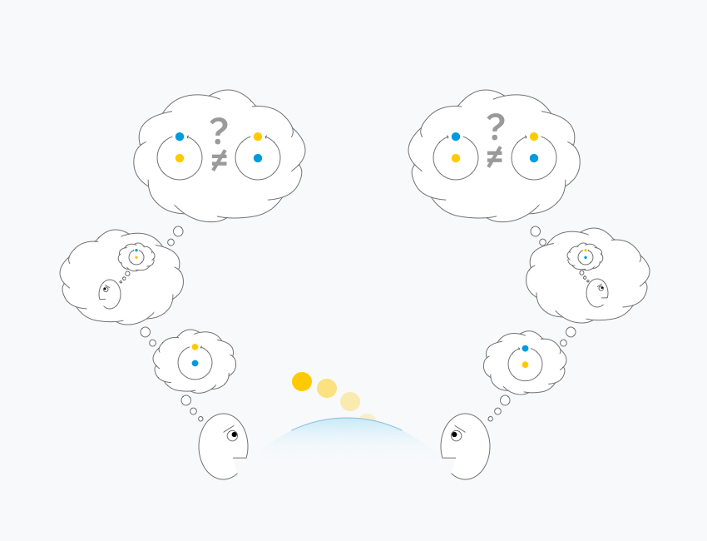
adapted from dubberly, model of models, 2009

Slide 25
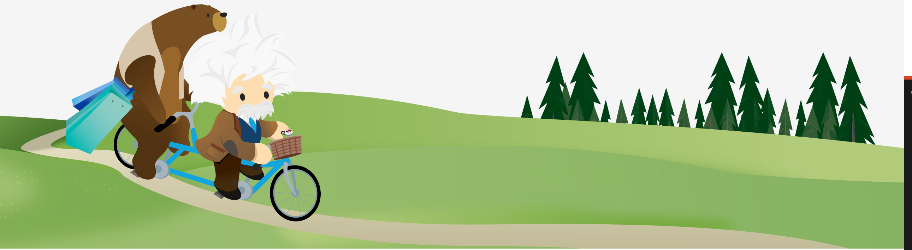
The Digital Machine
value model
object model
output
logic
interaction model
persona model
{
}
input
name:value
name:value
name:value
storage
data model

Slide 26
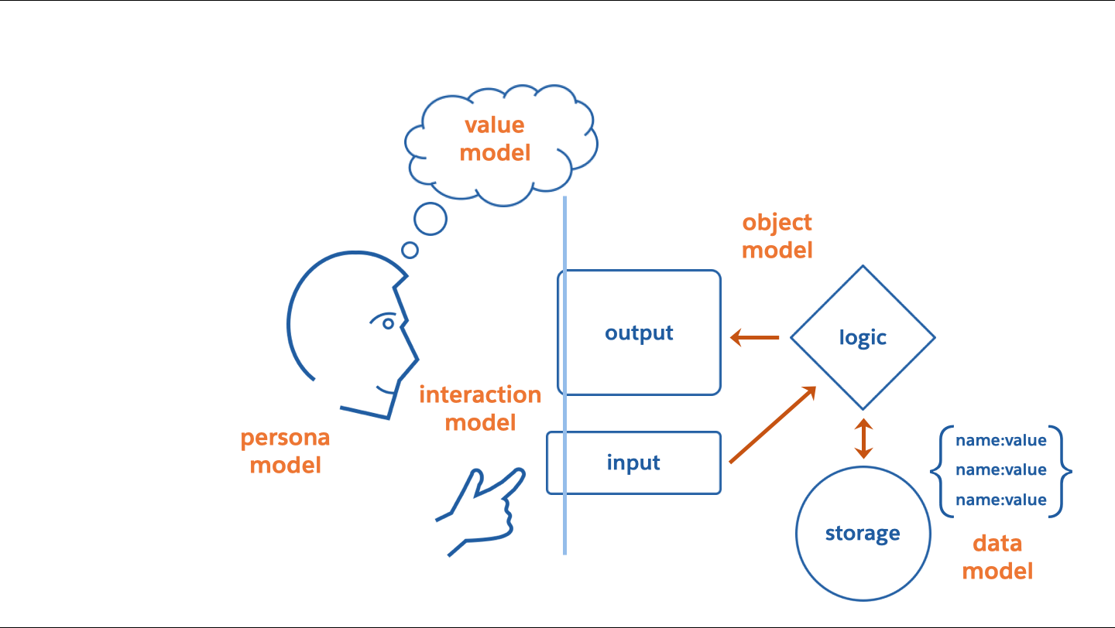
persona model

Slide 27


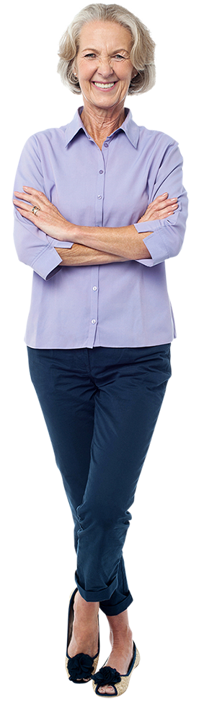


Interview people who might be your target user
A persona is a user archetype you can use to help guide decisions about product features, navigation, interactions, and even visual design.

Slide 28
Find common threads defining motivations, goals, frustrations, personality, technology, brands, etc.

Slide 29
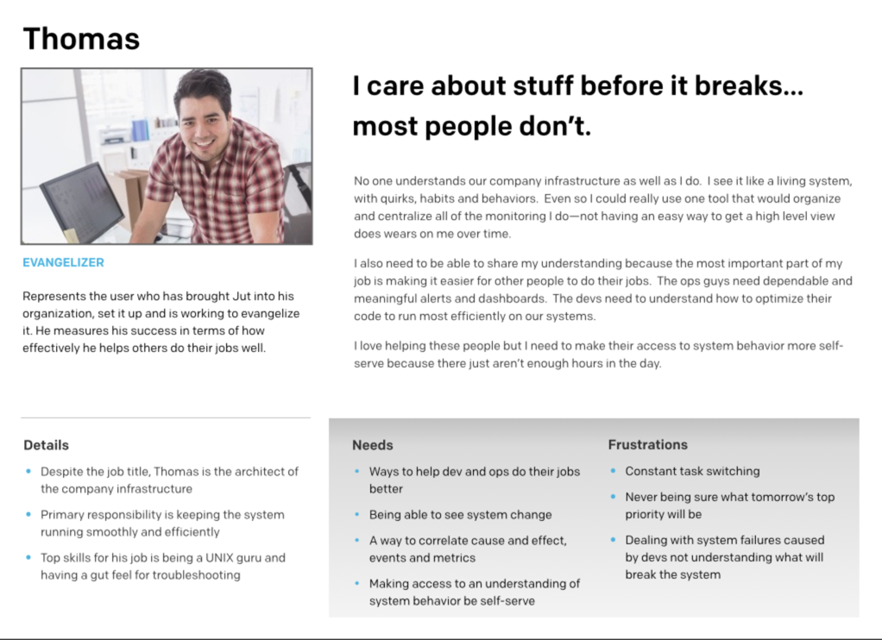
3. The Persona Model

Slide 30
The persona model is about empathy
for emotions, motivations, behaviors & priorities.

Slide 31
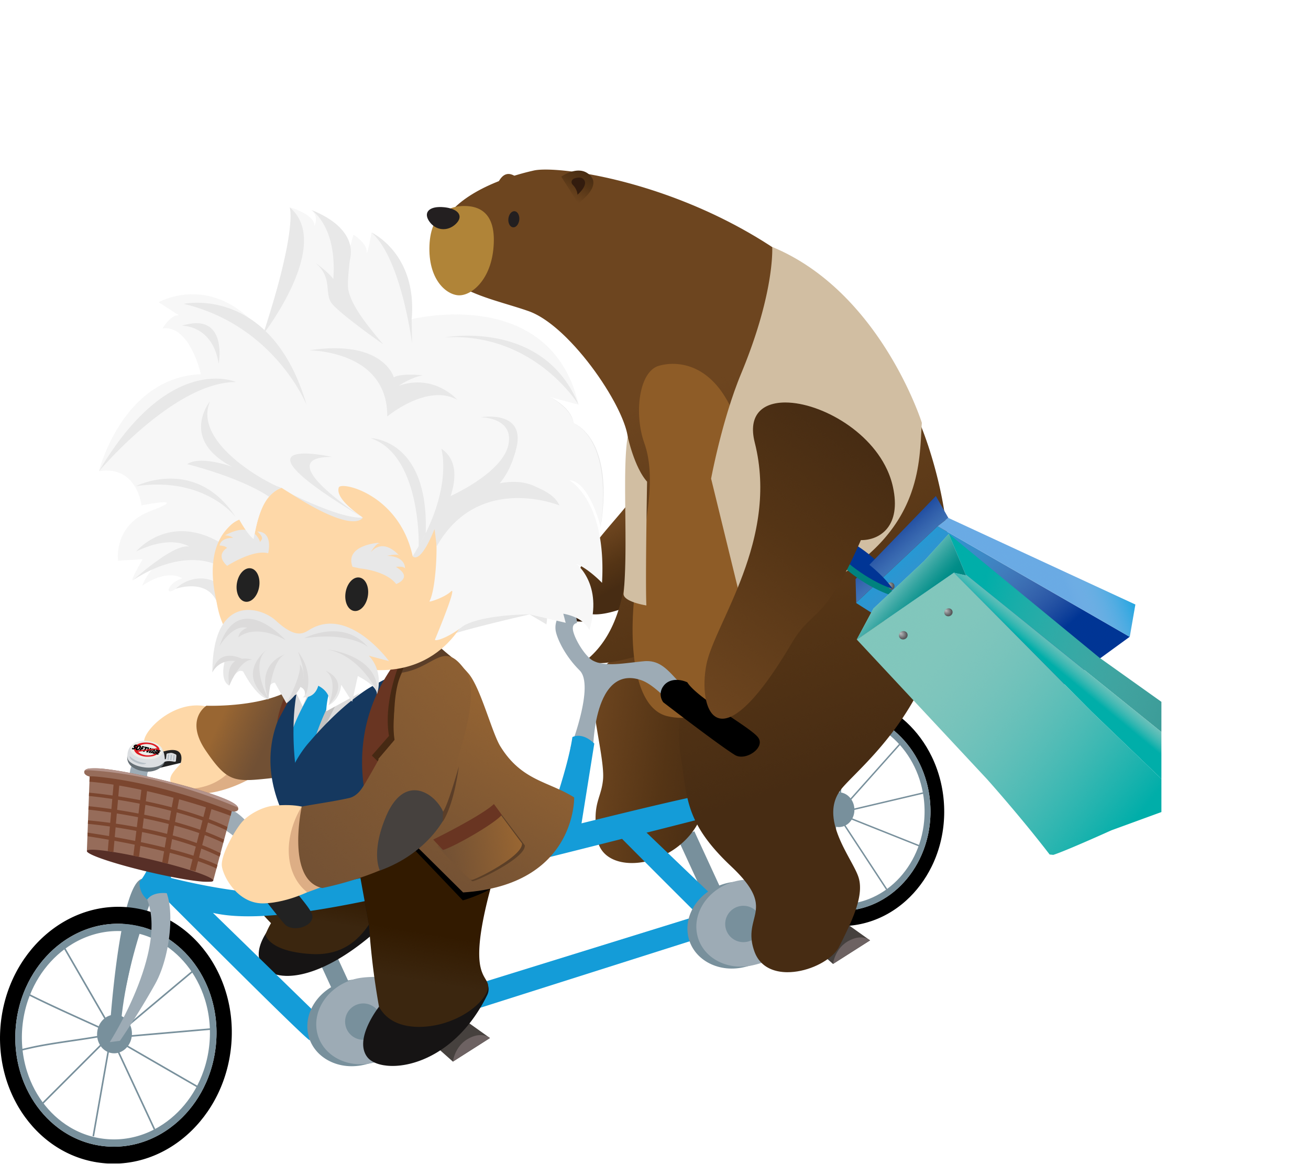
value model

Slide 32
Value Model
[The product] is a category of experience
that provides me with these benefits
and is better than the alternative for these reasons

Slide 33
Value Model
Facebook is a social media
that provides me with a way to connect with my friends
and is better than the alternative because it has great design.

Slide 34
Value Model
Facebook is a way to publish misleading political ads
that provides me with the ability to reach nearly 70% of US adults with targeted messages
and is better than the alternative because unlike Twitter, it will not monitor or fact check my political ads.

Slide 35
Value Model
Perceived
Persona Value
Company Perceived Value
Cool factor
Brand
Time Cost
Marketing
Revenue
Utility
Price
COGS

Slide 36

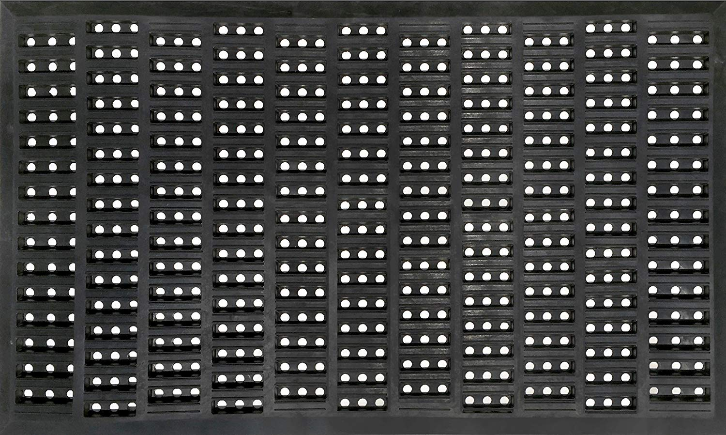
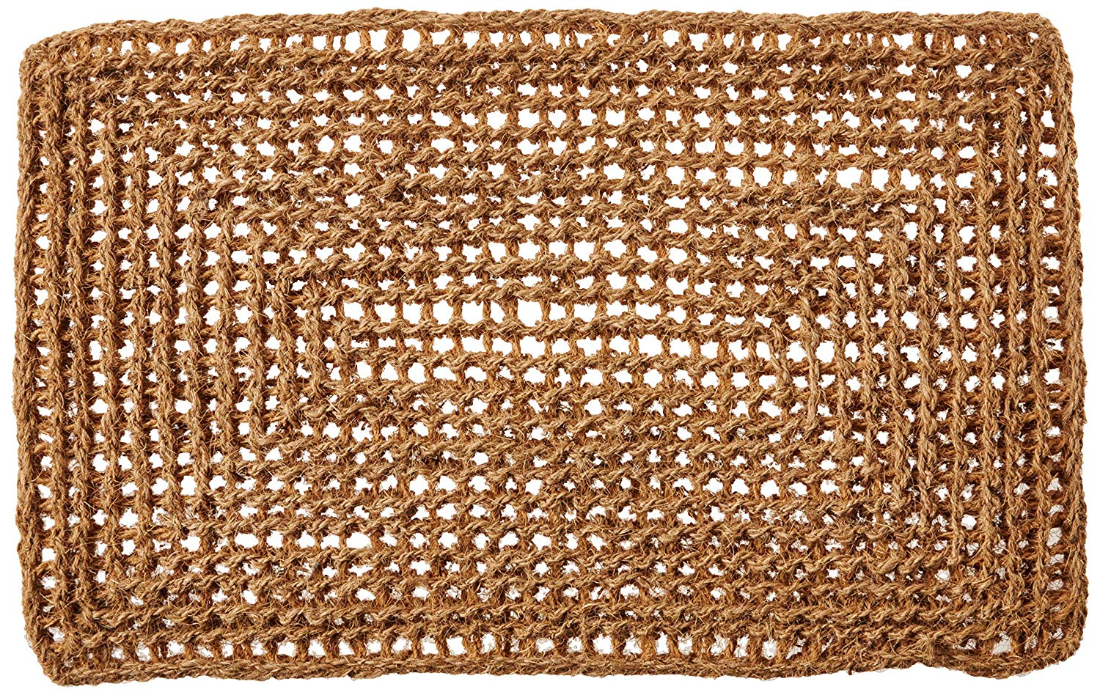
Which values matter to me?
Ottomanson Rubber
Doormat
Shepherd Hardware Recycled Rubber Door Mat
Kempf Rectangle Dragon Coco Coir Doormat
100% Rubber
Imported
Sturdy heavy non-slip rubber backing, SIZE: 18" x 30"
Scraping is easy thanks to its' zig-zag design texture
Durable recycled rubber construction
Designed for indoor or outdoor use
Fashionable geometric design
Effortless debris removal and water drainage
Unique Twisted Coir Fibers
100% All-Natural Coco Fiber
Traps dirt
Biodegradable
Long Lasting; Heavy Duty

Slide 37
Value Model
Kempf Dragon Coco Coir is a doormat
that provides me with excellent shoe cleaning
and is better than the competitors
because it doesn’t trap water that
rots my decking.

Slide 38
The value model is about value for the persona
not the business!

Slide 39
output
interaction model
input

Slide 40
Interaction Model
creating feedback that the system has changed
output
changes system state
user interaction
input

Slide 41
Interaction Model
button
button
'click'

Slide 42
Interaction Model
button.state = "up"
button.onClick = function() {
if (this.state == "up") {
this.state = "down";
}
if (this.state == "down") {
this.state = "up";
}
}
button.state = "down"
button
button
'click'
1
2
3
user interaction
changes system state
creating feedback that system state has changed
beginning
middle
end
time

Slide 43
Interaction Model
button.state = "up"
button.onClick = function() {
if (this.state == "up") {
this.state = "down";
drawButton(down);
}
if (this.state == "down") {
this.state = "up";
drawButton(up);
}
}
button.state = "down"
button
button
'click'
1
2
3
user interaction
changes system state
creating feedback that system state has changed
beginning
middle
end
time

Slide 44
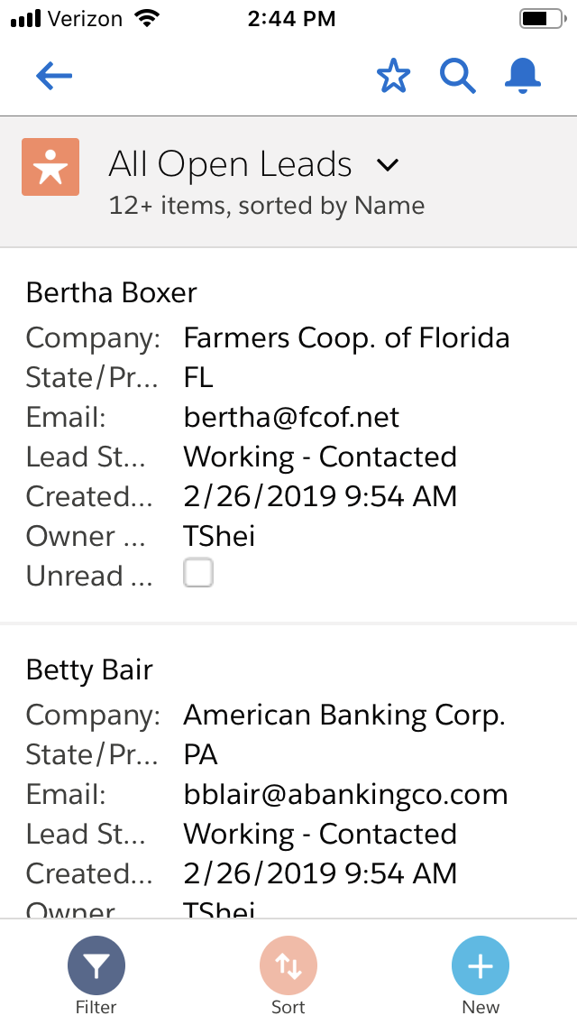
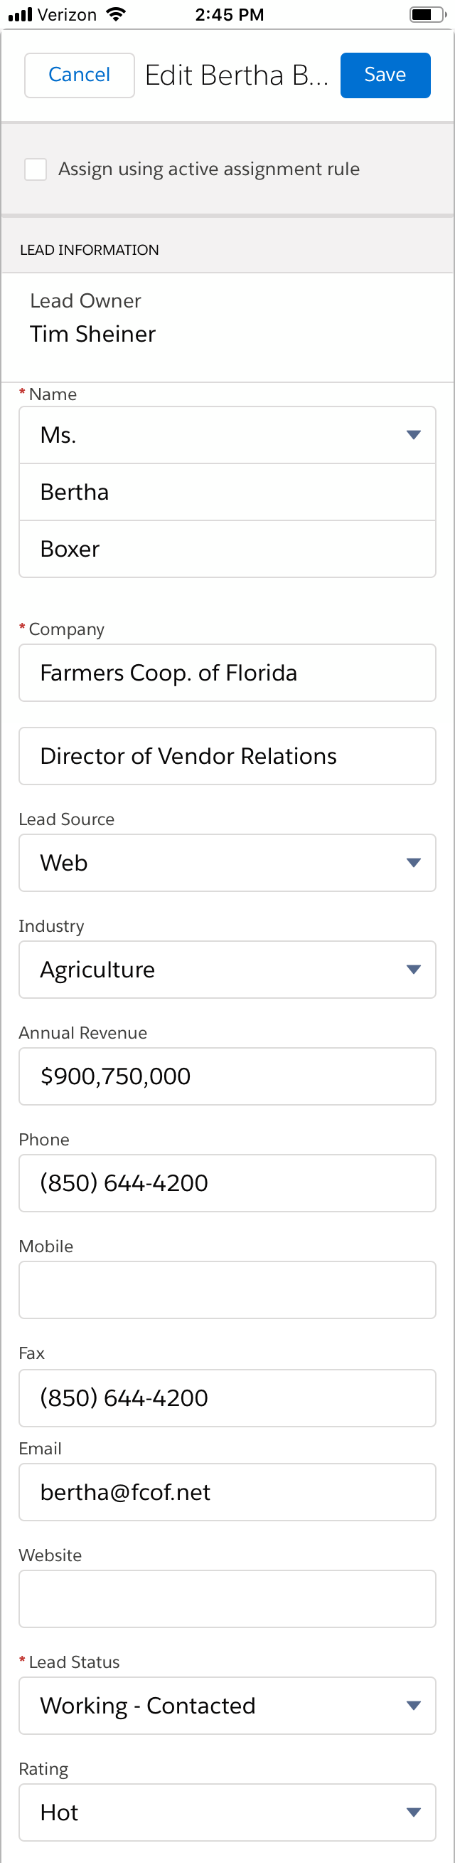
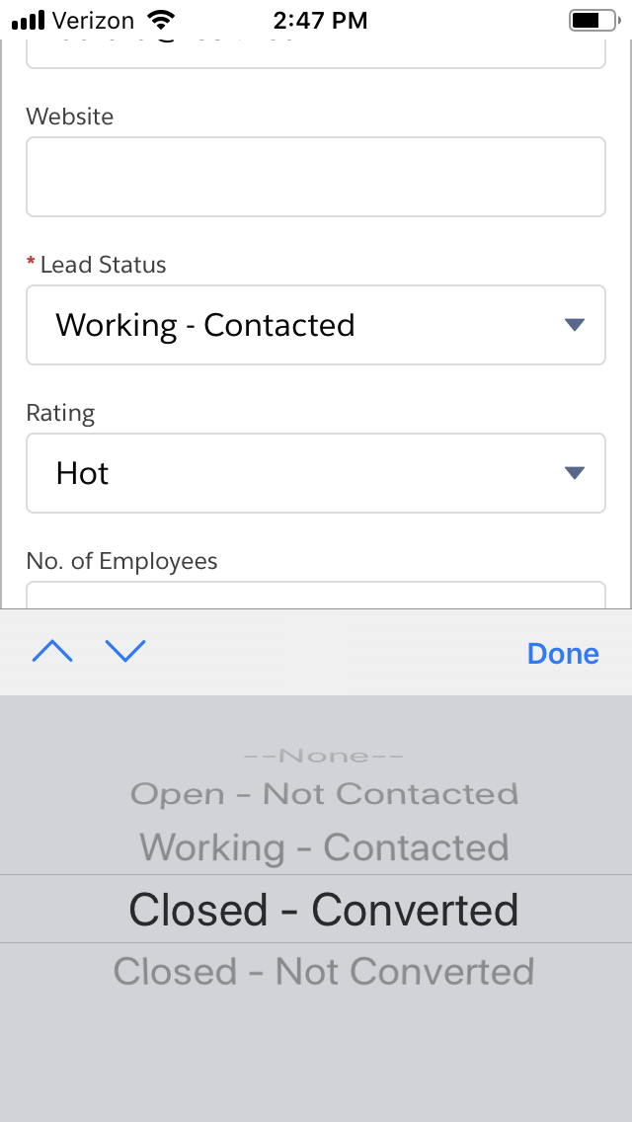
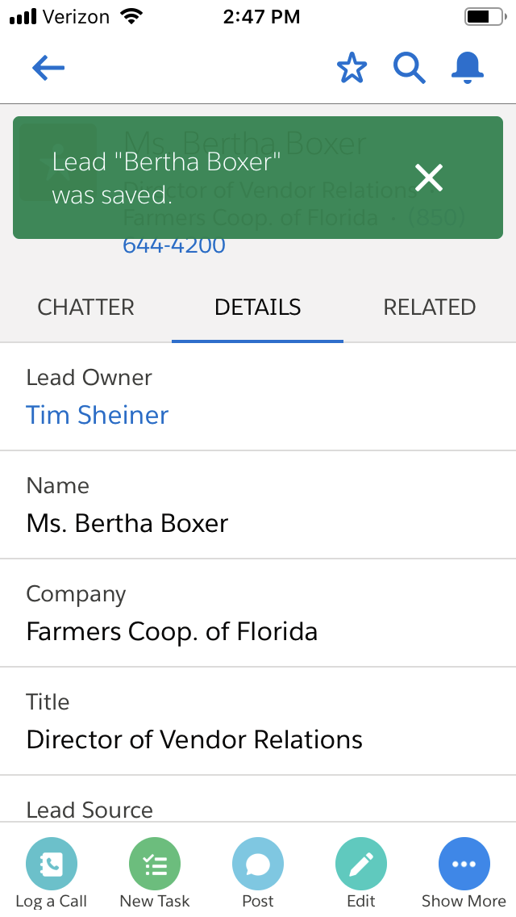
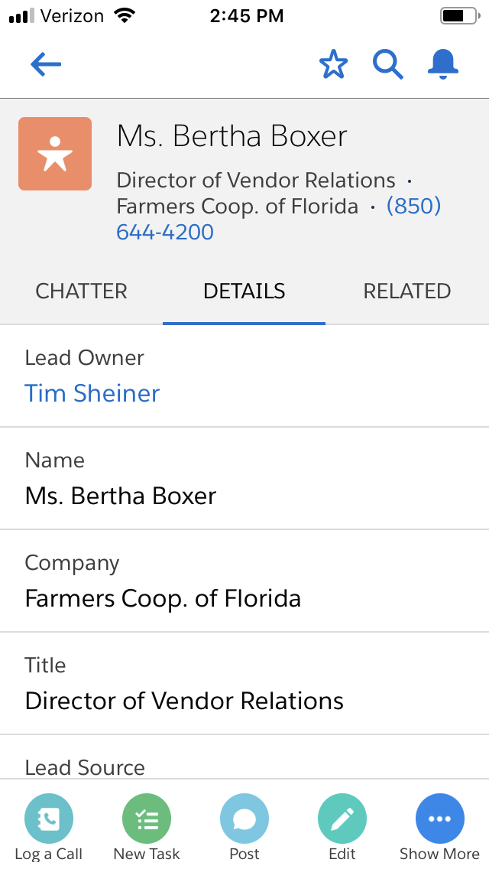
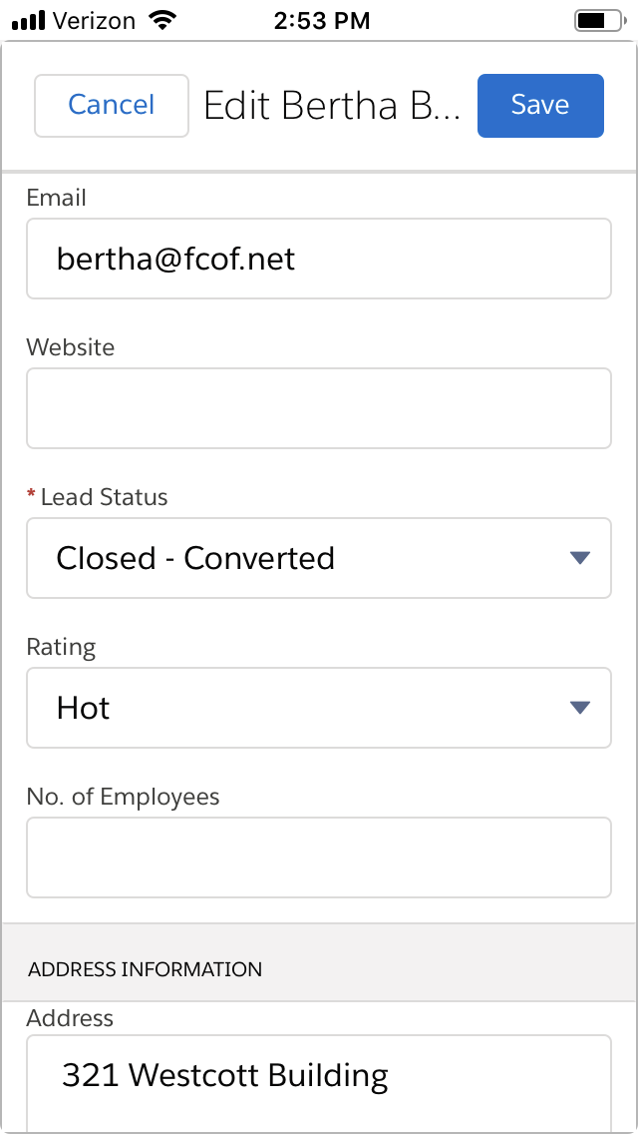
Interaction Model is a Story
A story about converting a lead
Go to Salesforce Mobile App
View my leads
Select a lead
Convert the lead
Save my changes
Be confident the change is recorded

Slide 45
The interaction model is a story
about getting stuff done.

Slide 46
object model
output
logic
input

Slide 47
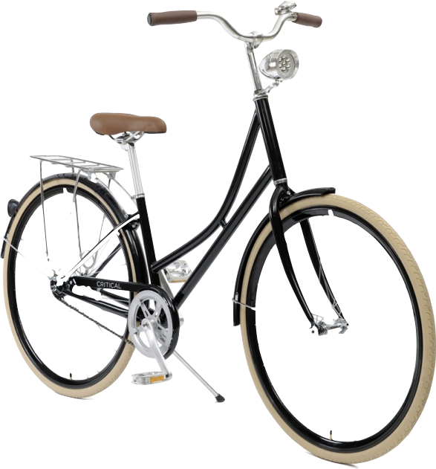
Object Model
Imagine we are designing a game about traveling by bicycle.

Slide 48
Object Model
fun!
origin
destination
trip

Slide 49
Object Model
The rider rides
the bicycle by sitting on
the seat, holding
the grips, moving
the pedals to go from
an origin to
a destination to complete
a trip.

Slide 50
Object Model
trip = {
vehicle: {
rider,
bicycle: {
grips,
seat
},
},
origin,
destination
}

Slide 51
The object model defines the names and relationships in the system.

Slide 52
{
}
name:value
name:value
name:value
storage
data model

Slide 53
Data Model
name:value

Slide 54
Data Model
x:7
pi:3.14
color:'green'
city:'san francisco'

Slide 55
Data Model
lat:37.78
long:-122.42

Slide 56
Data Model
seatPosition:{
lat:37.78,long:-122.42
}

Slide 57
Data Model
trip = {
vehicle: {
rider:'Thomas',
bicycle: {
grips:{
rotation:12,inclination:3
},
},
seatPosition:{
lat:37.78,long:-122.42
}
},
origin:{
name:'San Francisco',
position: {
lat:37.78,long:-122.42
},
},
destination:{
name:'Los Angeles',
position: {
lat:34.05,long:-118.24
},
}
}

Slide 58
The data model keeps the state
of the system.

Slide 59

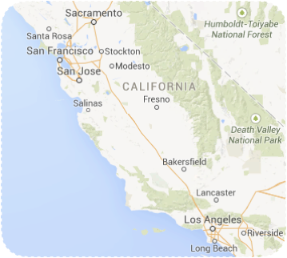
A Game Machine
fun!
seatPosition:{
lat:37.78,long:-122.42
}
seatPosition:{
lat:34.05,long:-118.24
}
1
2
3
user interaction
changes system state
creating feedback that system state has changed

Slide 60




A Game Machine
fun!
seatPosition:{
lat:37.78,long:-122.42
}
seatPosition:{
lat:34.05,long:-118.24
}
1
2
3
user interaction
changes system state
creating feedback that system state has changed

Slide 61
The Digital Machine
value model
object model
output
logic
interaction model
persona model
{
}
input
name:value
name:value
name:value
storage
data model

Slide 62
OK, so, models, cool.
But how does this help build better apps faster?

Slide 63
A shared framework makes team communication easier.
value model
object model
output
logic
interaction model
{
}
persona model
input
name:value
name:value
name:value
storage
data model

Slide 64
Modeling engages the creative power of visual and spatial thinking.
value model
object model
output
logic
interaction model
{
}
persona model
input
name:value
name:value
name:value
storage
data model

Slide 65
The team can work on pieces of the Digital Machine separately at the same time.
value model
object model
output
logic
interaction model
{
}
persona model
input
name:value
name:value
name:value
storage
data model

Slide 66
Team Triad
Product Manager
value model
interaction model
data model
persona model
object model
Developer
Designer

Slide 67

http://bit.ly/thedigitalmachine
Read the blog post

